Slide 1
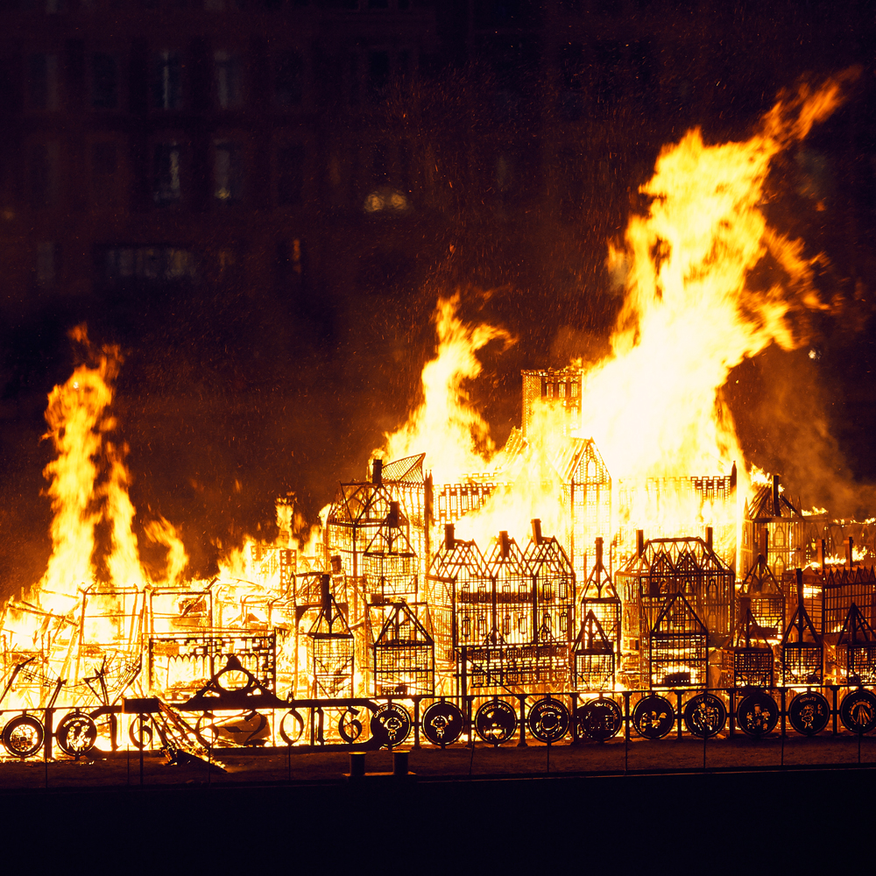
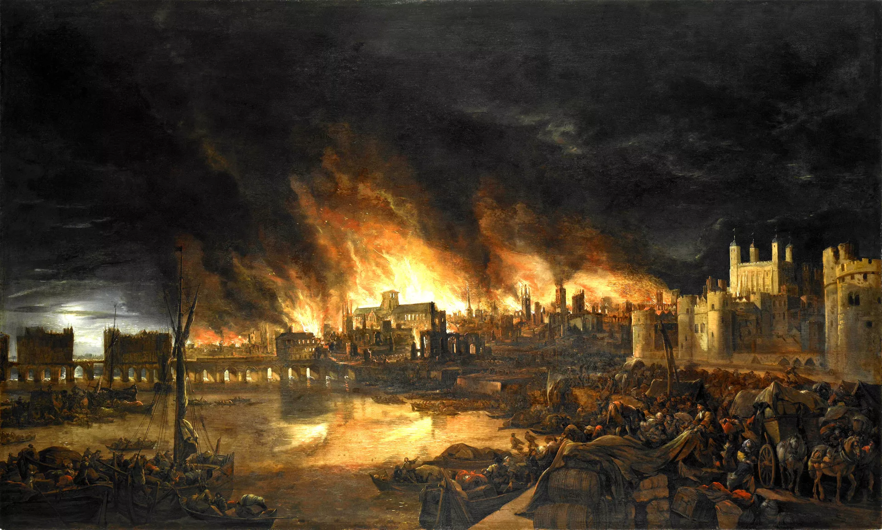
Year 2 Autumn Term Topic Overview
The Great Fire of London
Topic overview:
We have started our new topic which explores everything about The Great Fire of London.
We will be comparing London now and London during 1666, we will explore the events of the Great Fire of London through drama and dance.
Reading
All children will have a share with me book to read at home. These will be changed once a week in school.
Please write in the reading diary, each time your child reads at home. When reading at school children will have a different book to decode that uses the sounds they have learnt in phonics and they will read this 3 times a week.
Important information:
Some children will be sent home with coloured word set cards to practise.
PE kits need to be in school everyday and all items must be named. Year 2 PE will be on Thursdays. Please send in a water bottle for your child.

Slide 2
This term we will be learning…
English | In English we will explore character descriptions of Traction Man. We will be reading fiction and non-fiction stories about the Great Fire of London. We will be focussing on our capital letters, full stops and the use of adjectives and noun phrases in our writing. | Design and Technology | In D&T we will be following a recipe to make bread, We will also design, make and evaluate a fire engine, using wheels and axels to make the vehicle move. We will design, make and evaluate a Tudor house. At Christmas we will make a Christmas card using a hinge or lever.
Maths | In Maths we are looking at partitioning numbers to 100 using our tens and ones. We will look at addition and subtraction of 2, 2 digit numbers, We will learn our multiplication facts of 2s, 5s and 10s. | Art and Design | In Art we will be using texture and different line patterns to make a fire scene, We will research and create art, in the style of Giuseppe Arcimboldo. We will manipulate and explore the suitability of materials to create objects that travel. We will create art work for the whole school display, linked to a story.
Science | In Science we will be describing the importance of exercise and healthy eating for humans and exploring their needs of survival. We will also be identifying and comparing the suitability of a variety of different materials. | Music | In music we will be singing songs to explore the events of the Great Fire of London through singing and music. We will be learning about pitch, tempo, volume, rhythm and duration whilst creating music. We will be creating digital music using chrome music lab.
Geography | In Geography we will be comparing London now and London in 1666, through the use of maps and photographs. | Religious Education | In RE we will begin by learning about Christianity and the ‘good news’ that Christians believe Jesus brings. We will explore the question, ‘why does Christmas matter to Christians?’.
History | In History we will be exploring the Great Fire of London through texts, photographs and research. We will create a timeline of the events of the Great Fire of London. We will research Samuel Pepys, taking extracts from his diary. | PSHE | In PSHE we will learn all about ourselves and our family, how we grow and how we change. We will discuss how to be a good friend and who is special to me. We will talk about what we are good at. During PSHE we will also discuss school rules and how to be safe in the community.
Computing | In Computing we will be finding out about IT around us and how we use IT in our daily lives. We will be using chrome music lab to create digital music. We will be exploring technology safely. | Physical Education | In PE lessons we are fortunate to have ASM support our gymnastics. We will also be exploring the events of the Great Fire of London through dance.

